Slide 1
11 Architecture Design Practices
Copyright 2021 Tencent, Inc. or its affiliates. All rights reserved.

Slide 2
Chapter Objectives
After completing this course, you will be able to:
Practice how to optimize the architecture design
Understand how to conduct system research
Understand the modular architecture

Slide 3
Section 1. Case Background
Section 2. Stage 1: Improve Service Stability
CONTENTS
Section 3. Stage 2: Provide Service in Multiple Regions
Section 4. Stage 3: Optimize Architecture Based on Business Process

Slide 4
Section 1. Case Background
Section 1. Evolution of Cloud Computing
1.1 Course introduction
CONTENTS
1.2 Basic components of a bike sharing system

Slide 5
1.1 Course introduction
The rapid expansion of a bike-sharing company "X-bike" after its launch brought serious challenges to the system architecture. The following will describe the problems encountered by X-bike in the three stages of IT architecture optimization, and trainees will be divided into groups of four to discuss and propose corresponding solutions.
Improve service stability
Provide the service in multiple regions to attract more users
Optimize the architecture based on the overall business process

Slide 6
1.2 Basic components of a bike sharing system
Bike
1. Scan QR code
3. Lock manually
User
Smart lock
Mobile phone
2. Unlock
ISP network
Connection management platform
Wireless wide area network (WWAN)
Bike sharing application
Integration
Map
Bike management
Remote unlocking
Billing
User management
Payment
Notes:
The business process of bicycle sharing needs to connect bicycle and user through application, and the components can be divided into backend application, cell phone application and bicycle smart lock. The backend application interacts with the cell phone application and the bicycle smart lock through the wide area wireless network to realize the management of user data and bicycle data.

Slide 7
Section 2. Stage 1: Improve Service Stability
Section 1. Evolution of Cloud Computing
2.1 Service status
CONTENTS
2.2 Architecture research principles
2.3 Troubleshooting
2.4 Architecture scheme design

Slide 8
2.1 Service status
Stage 1: X-bike, as a startup team with weak technical capabilities, just started its bike sharing business. The IT applications were deployed in its local data center, and all components (MongoDB, MySQL, Redis, etc.) were self-built
Problems: the service was unstable, and the whole business often failed slightly or severely
MongoDB and MySQL directly failed during peak hours
Various Redis clients couldn't be connected
Troubleshooting and recovery were slow
Bike server
Nginx
API
Service
Nearby
Redis
MongoDB
MySQL

Slide 9
Group discussion
Time limit: 15 minutes for discussion and 5 minutes for presentation for each group
Please think about the following questions about this case:
1. What information is required to make a scheme before architecture optimization?
2. What are the possible causes of the aforementioned problems?
Group output:
1. Environment research principles
2. Possible causes

Slide 10
2.2 Architecture research principles
Server
Business overview
Storage
Business architecture
Computing, storage, and network
Business requirements and challenges
Network topology
System research
Application architecture
Security protection system
Basic architecture research
Regions and AZs
Layout of regions and AZs
Application attributes
Application and data architecture
Guarantee for business continuity
Data architecture
OPS pressure and challenges
Manpower
Data attributes
Efficiency
Notes:
Research content outline
Research from both application and infrastructure aspects
System Research
Business architecture: understand the information about the business type, requirements and pain points related to the system, and determine the requirements for running the application based on this information
Application and data architecture: understand the application architecture composition, technology stack, access volume, user distribution and other attributes of the application system; understand structured data, unstructured data architecture, understand data volume size, data growth and other attributes
Infrastructure Research.
Understanding of underlying compute, storage, network, security and other attributes
Understand regional and availability zone distribution
Understand O&M pressures and pain points

Slide 11
2.2.1 System research
System research consists of four parts:
Business research
System architecture research
Database research
Application research
Item | Content
Business research | System name, owner unit, business description and service objects, development/operation status, and system type
System architecture research | Peripheral device and commercial software requirements
 | Network requirements
 | Transformation rules
 | Dependency of system modules
 | Security requirements
 | Resource utilization
 | System type

Slide 12
2.2.1 System research (continued)
Item | Content
Database research | Database vendor/version
 | Database architecture (RAC? Primary/Secondary?)
 | Backup policy (cold backup, hot backup, and backup cycle)
 | Database capacity and traffic statistics (peak TPS, QPS, and number of connections)
 | SQL collection (top 50 SQL queries with the highest number of database access requests and slow SQL queries)
 | Collection of advanced database features (stored procedures, functions, triggers, and full-text indexes)
 | Database character set

Slide 13
2.2.1 System research (continued)
Item | Content
Application research | Does it have high availability and high performance design?
 | Application programming language and development framework
 | Application architecture (B/S or C/S)
 | Data and log storage methods
 | Are third-party services or components used?
 | Are external APIs or services called?
 | Is middleware used?
 | Are custom-made plugins used?
 | Is document storage available?
 | Are multiple data sources used?
 | What are the system performance metrics?

Slide 14
2.3 Troubleshooting
Research finds that the following major performance bottlenecks of the backend applications:
Business layer: non-standard design
Data layer: low performance and availability
Cache layer: bottleneck with the number of connections
Main problems
The overall service configuration and business data flows were non-standard (one server had multiple processes), making it difficult for management and troubleshooting
MongoDB and MySQL databases were CVM-based self-created with poor business syntax, performance, and availability and without professional DBA and monitoring (various exceptions occurred during peak hours)
Redis was self-built with poor performance and an upper limit of 2,000 for the number of connections

Slide 15
Group discussion
Time limit: 15 minutes for discussion and 5 minutes for presentation for each group
Please think about the following questions about this case:
1. How do we solve the problems of the data and cache layers at the architecture level?
2. How do we design the architecture after the business is migrated to Tencent Cloud?
Group output:
Architecture diagram based on Tencent Cloud services

Slide 16
2.4 Architecture scheme design
Architecture design principles
Use Tencent Cloud PaaS services to replace self-built MongoDB and MySQL databases to simplify database OPS and implement elastic scaling when the performance hits the bottleneck
The maximum number of connections of TencentDB for Redis reaches 10,000, breaking through the original technical bottleneck. It can be upgraded to the distributed edition when the business grows
Find experts to optimize the original database statements to improve the execution efficiency
Nginx
Nginx
Bike server
Application API
Architecture after migration
Service
Nearby
TencentDB for Redis
TencentDB for Mongo
TencentDB for MySQL

Slide 17
Section 3. Stage 2: Provide Service in Multiple Regions
Section 1. Evolution of Cloud Computing
3.1 Business traffic surges in multiple regions
CONTENTS
3.2 Architecture optimization principles
3.3 Reference scheme

Slide 18
3.1 Business traffic surges in multiple regions
After X-bike was migrated to Tencent Cloud, it started to develop in many regions, and its business was fully rolled out, with users and traffic increasing rapidly
After the beginning of spring, the number of weekly orders doubled, and the number of daily orders soared up to over 10 million or even 20 million
The architecture before full optimization at the early stage couldn't support the rapid business growth, and the entire X-bike business encountered unprecedented technical challenges
Nginx
Nginx
Bike server
Application API
Service
Nearby
TencentDB for Redis
TencentDB for Mongo
TencentDB for MySQL
The data volume grows fast
The database is split horizontally

Slide 19
Group discussion
Time limit: 20 minutes for discussion and 5 minutes for presentation for each group
Please think about the following questions about this case:
1. How do we deal with the surges in user volume and traffic of the business in multiple regions at the architecture level?
2. How do we use Tencent Cloud services to solve these problems at the architecture level?
Group output:
Architecture diagram based on Tencent Cloud services

Slide 20
3.2 Architecture optimization principles
Consider the following factors based on the corresponding characteristics of the bike sharing business:
Acceptable system latency as the business runs in multiple regions
Ability of the IT architecture to quickly respond as the business needs to be rolled out in new regions and starts region-specific operations
System availability and disaster recovery as the bike sharing business runs 24/7
Transformation to the modular architecture
Nearby access and acceleration
Multi-Data center and multi-site active-active architecture

Slide 21
3.2.1 Database sharding and modular transformation
Application cluster
Module 1
Module 2
Module 3
Node 1
Node 2
Node 3
Node 1
Node 2
Node 3
Shard 1
Shard 2
Shard 3
Shard 1
Shard 2
Shard 3
Horizontal database sharding
Modularization
Notes:
Unitary architecture: Unitary architecture has evolved from the field of parallel computing. In the field of distributed service design, a unit is a self-contained installation that satisfies all business operations of a partition
Data partitions: All nodes of the same application connect all data partitions of this business, and several data partitions are deployed on each partition. Any application node may receive business requests from any user, and then access the data of the corresponding sub-base according to the data partition rules.
Unitization transformation: The database has a limited number of connections, and when the business keeps growing, the nodes increase, which will occupy the number of connections of each sub-base and gradually degrade the performance, in a unitized way, the application server in each unit only connects to the data sub-base of this unit.

Slide 22
3.2.2 Regional data and global data
Global data
User account
User ride status
Account balance
Regional data
Bike ride record
Bike position
Other bike information
Notes:
A unit is a self contained installation that satisfies all business operations of a certain partition. When doing the splitting of the database, the bike data and operation data of different cities can be put in the corresponding units, but data like user account information, which needs to be globally synchronized, cannot be used as regional data.

Slide 23
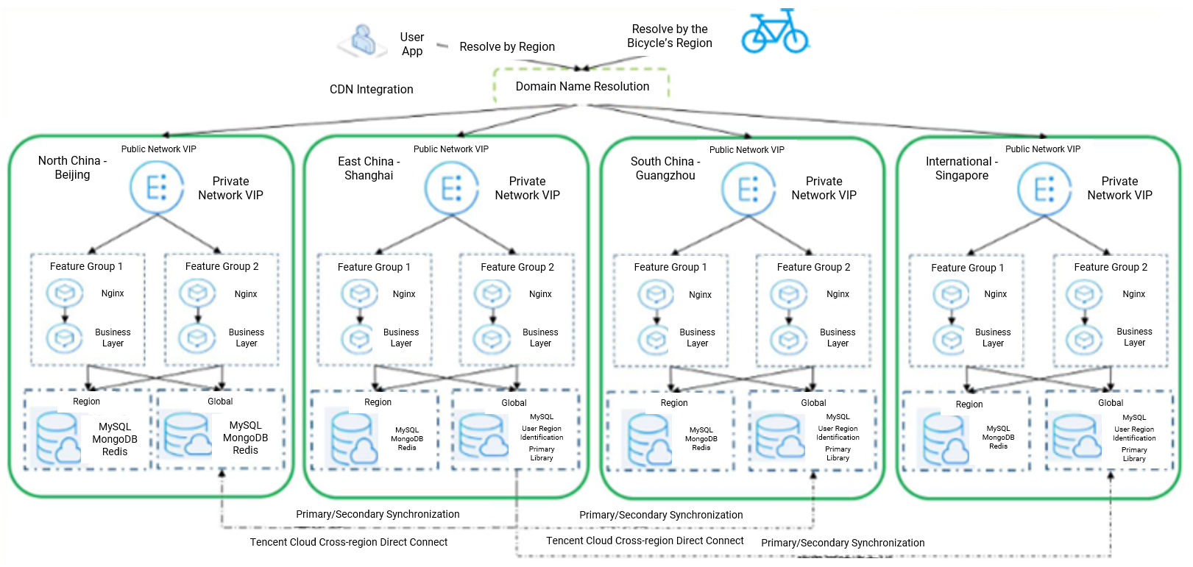
3.3 Reference scheme

Slide 24
Section 4. Stage 3: Optimize Architecture Based on Business Process
Section 1. Evolution of Cloud Computing
4.1 Overall business process
CONTENTS
4.2 Optimization principles

Slide 25
4.1 Overall business process
Bike-Backend communication Application-Bike communication Application-Backend communication
Core factors
User
Bike
Order
Payment
IoT
Bike
1. Scan QR code
3. Lock manually
User
Smart lock
Mobile phone
2. Unlock
How to connect
How to connect
ISP network
Connection management platform
WWAN
Bike sharing application
Integration
Map
Bike management
Remote unlocking
Billing
User management
Payment
Notes:
When considering IT system architecture, you need to start from the whole business process, not only in the design of the background application, people, vehicles, applications

Slide 26
Group discussion
Time limit: 20 minutes for discussion and 5 minutes for presentation for each group
Please think about the following questions about this case:
1. How do we optimize the communication between bikes and the backend on a weak network?
2. How do we set the unlocking method to improve the unlocking success rate and shorten the unlocking time?
Group output:
Architecture optimization scheme

Slide 27
4.2 Optimization principles
Cloud-Terminal communication optimization
Communication optimization
Distribute information such as billing
Report status
Unlock
Request unlock
Scan QR code

Slide 28
4.2.1 Application connection optimization on weak network
Bike sharing covers most urban areas. How do we guarantee network access in places with poor network receptions (such as basement)?
Direct IP connection: avoids DNS hijacking and DNS loss
Linkage multiplexing: uses the TCP multiplexing technology to reduce consumption and improve concurrency
Optimal access: combines nearby IP access and dynamic speed test to select the optimal IP
Traffic compression: uses traffic optimization schemes such as GZIP compression and merge of repeated data on the backend
Dynamic combination of ports 80/8080/14000/443: detects port availability
Use of HTTP/TCP protocols together: detects availability and uses the more efficient TCP protocol preferably
TCP protocol stack optimization: covers thin-streaming, Westwood, and dynamic MSS adjustment

Slide 29
4.2.2 Communication guarantee for cloud-controlled bikes
Communication Method | Description
Unlocking with GMS SMS | The smart lock has a built-in SIM card and uses 2G network for unlocking with SMS. The unlocking takes about 10 seconds, which is stable. This method requires persistent connection to the network and thus has high power consumption and short standby time.
Unlocking with GPRS traffic | The smart lock has a built-in SIM card and uses GPRS traffic for unlocking. The unlocking takes about 3 seconds. However, GPRS has network dead zones, where the smart lock cannot be used. A 4G module can be added to solve this problem, but the cost is high.
Unlocking with Bluetooth | After passing the authentication at the business layer, an encrypted instruction package is downloaded to the phone and then sent to the Bluetooth module for unlocking. However, phone vendors have poor Bluetooth compatibility, which leads to a low unlocking success rate. Therefore, this method can be used as an auxiliary for unlocking with traffic.
Unlocking with NB-IoT/eMTC | It has low power consumption and wide coverage. NB-IoT is less sensitive to latency, has a very high requirement for low costs, and uses very little data traffic, while eMTC has a better support for mission-critical services that require high reliability and is therefore more suitable for latency-sensitive scenarios. The use of NB-IoT is more conducive to information interaction, and more data can be obtained in the cloud.
The current mainstream method is to use multiple communication methods together to complement each other and install a multi-mode chip of NB-IoT+eMTC+2G on the smart lock. It not only improves the unlocking experience but also solves the bike management problem on the backend to implement data-driven operations.
Notes:
Narrowband IoT (NB-IoT/eMTC) technology provides a connection between the bike lock and the application server, allowing the lock to synchronize various information from the server, such as lock status, bike location and unlock code.
Compared with the GSM technology previously used for bike-sharing, NB-IoT technology has excellent performance advantages in terms of coverage, capacity and power consumption. With NB-IoT technology, a single battery can support the whole bicycle for 2-3 years without any external power assistance.

Slide 30
Thank you!

